Slide 1
PROXIMITY
Presentation Slides
Group 16: RYAN ROTTMANN, RYAN WORTMANN, SONG VU NGUYEN, NATHAN KULZCAK, JOHN OATELY

Slide 2
What is Proximity?
Proximity is a social media site built with location and face to face interactions in mind.
The idea is to get people meeting up in person again!
Do this through keeping track of proximate events/friends and encouraging the user to go to them.
Proximity is meant to work, even when the user does not have internet access.

Slide 3
Modules
AccountModule: CreateAccount(),VerifyLogin()
MapModule: GetEvents(), CreateEvents(),DeleteEvent()
FeedModule: GetFeed(),CreatePost(),DeletePost()
MessagingModule: GetMessages(),CreateMessage(),DeleteMessage()
SearchModule: Search()
GroupModule: GetGroups(),CreateGroupPost(),CreateGroupInvite(),DeleteGroup(),DeleteGroupPost()

Slide 4
System Requirements
Screen Display
An internet connection
A modern web browser (Not internet Explorer)
Notes:
Need a modern web browser for location data
Will work on mobile devices

Slide 5
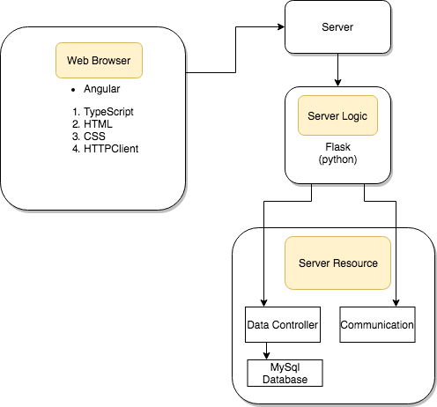
System Diagram

Slide 6
Plan of Work
For the rest of the semester, we going to continue working on and improve the web app:
Implement direct/group messaging
Add friends
Finish map function-enable user to create and view events on the map
Improve the design and content layout of our webapp to look more professional

